Slide 1
Low-cost, open-source, flexible current feedback-controlled coil driver circuit for matrix B₀ shim coils and related applications
Nicolas Arango¹, Jason P Stockmann², Thomas Witzel^{2,3}, Lawrence L Wald^{2,3}, Jacob White¹
¹ Department of Electrical Engineering & Computer Science, Massachusetts Institute of Technology, Cambridge, MA, USA
² Martinos Center for Biomedical Imaging, Massachusetts General Hospital, Charlestown, MA, USA
³ Harvard Medical School, Boston, MA, USA

Slide 2
Nick Arango

Slide 3
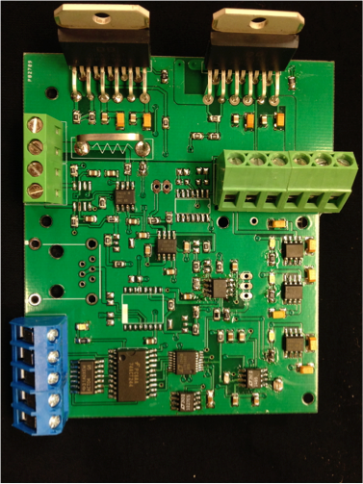
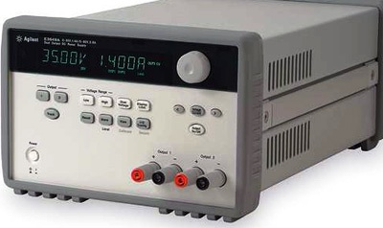
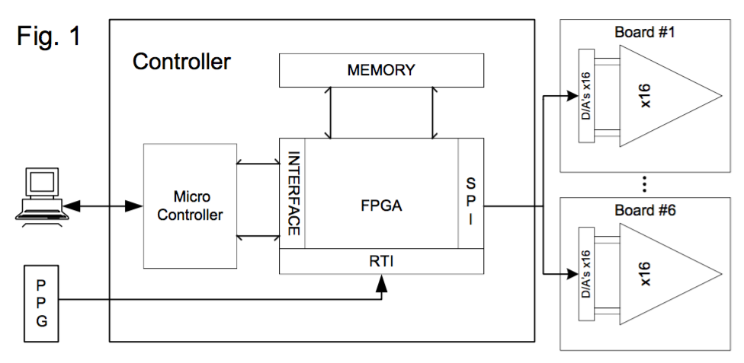
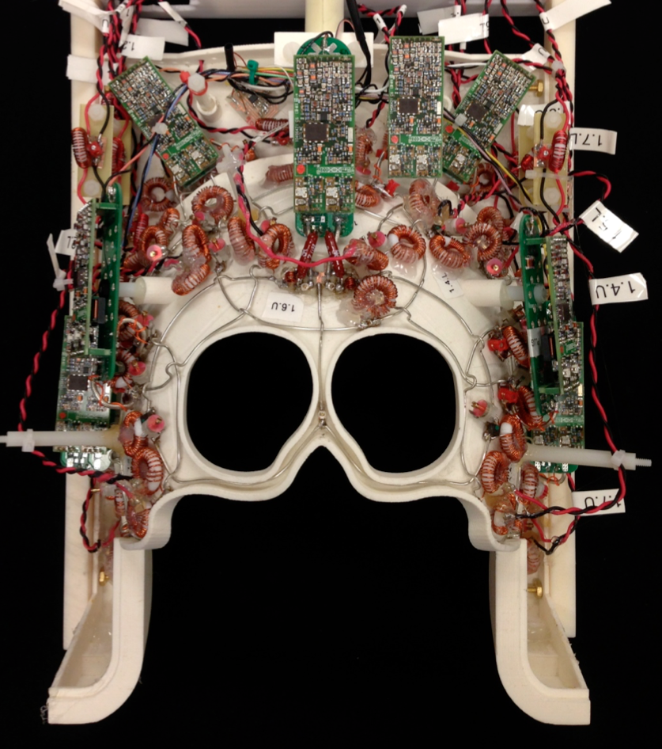
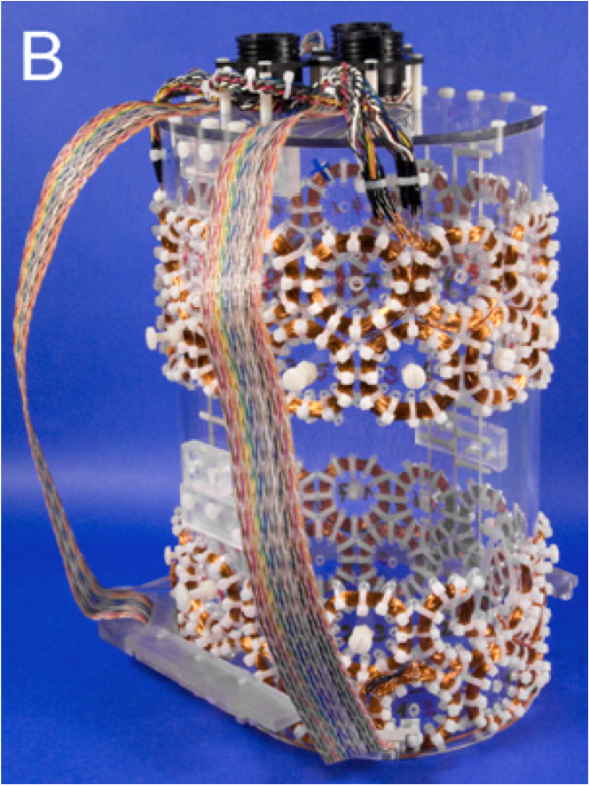
Original Motivation: Flexible local-multicoil B0 shim array driver
Cost of one-off shim drivers
Non-recoverable engineering time
Impedes reproducibility
Too costly for classroom use
Distracts researchers from MR physics and clinical applications
MGH First Gen. driver
(courtesy Thomas Witzel)
Yale modular driver array
Agilent E3648A DC supply
Diversity of multi-coil shim arrays:
Truong et al., NeuroImage 2014
Stockmann et al., MRM 2015
Juchem et al., JMR 2010

Slide 4
Low-cost and available hardware
Low cost, commodity parts, under $70 per channel
One day assembly by technician or turnkey assembly from multiple vendors
Rapid rise time for dynamic shimming of single and multi-turn local shim coils
Low distortion driving resonating coils
Stable low RF noise for use in the magnet room
Notes:
Low cost
Capable of shimming Waveforms driving single and multiturn local shim coils and resonating coils
Low noise and usable in magnet room

Slide 5
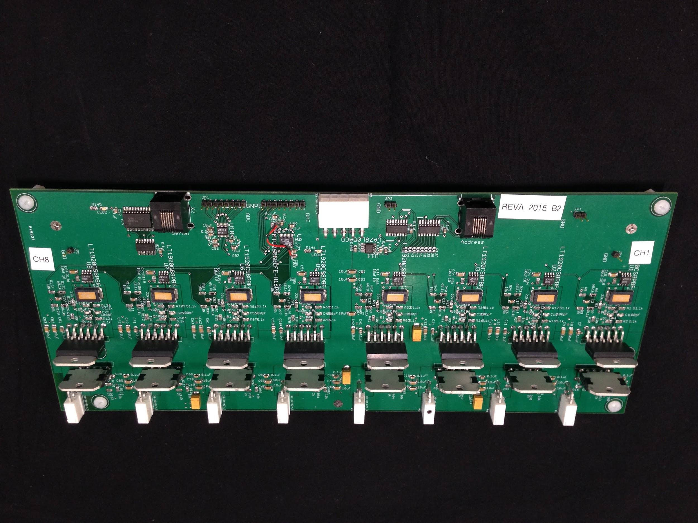
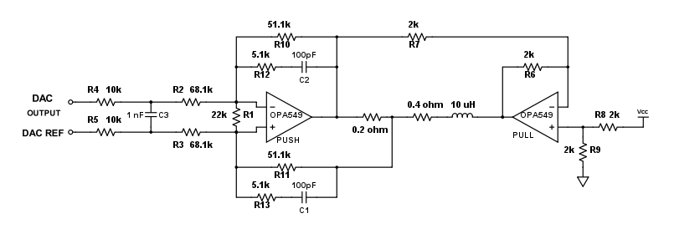
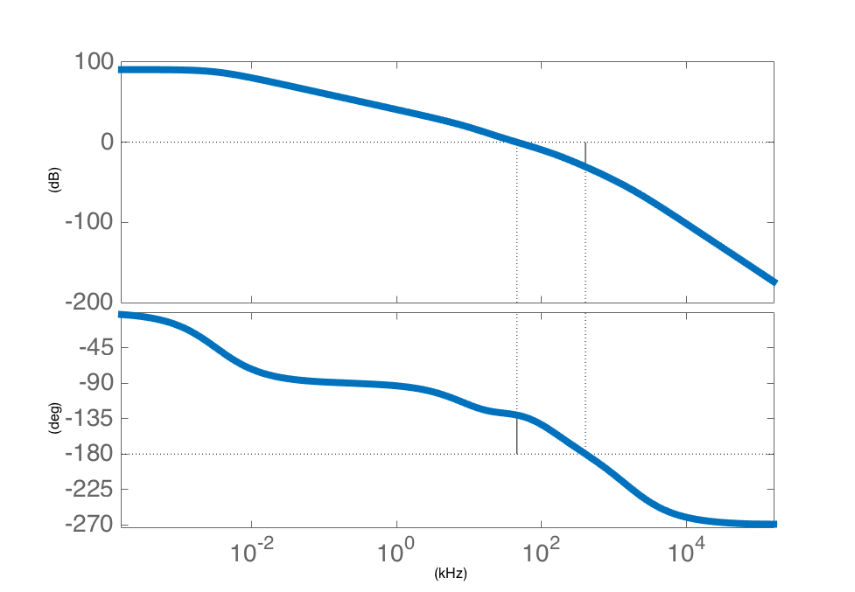
Methods: Linear, current feedback, lead-compensated push-pull
Single channel
Lead Compensated Open Loop Bode Plot
Gain (dB)
~20KHz bandwidth
Phase (deg)
Frequency (kHz)
49.5 degree phase margin

Slide 6
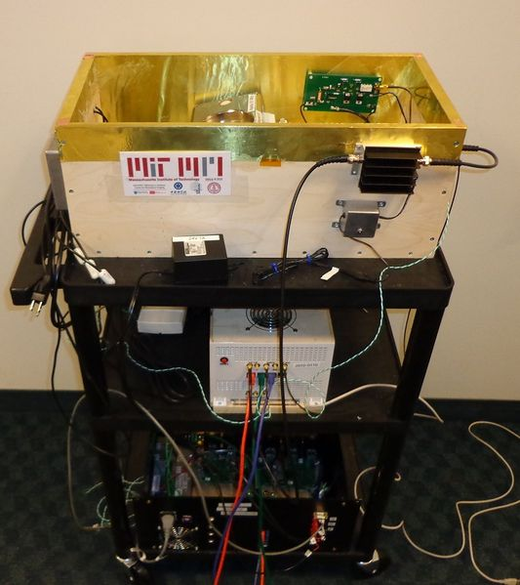
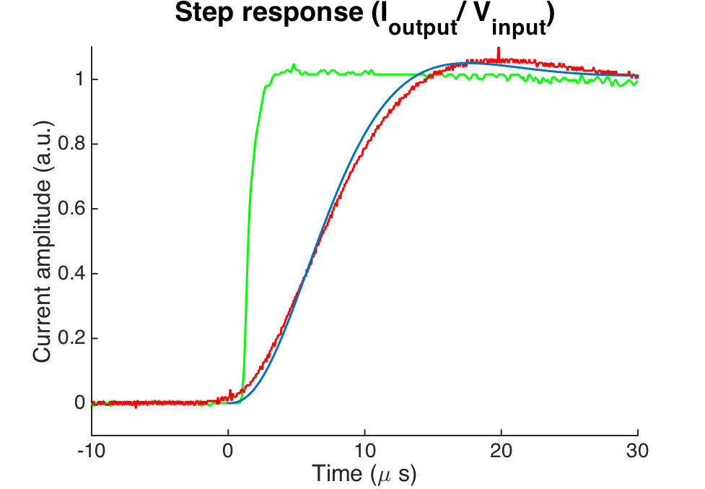
Results: High performance in diverse applications
Driving 10uH load
20𝜇s rise time
50uH load
Driving 690uH load
200𝜇s rise time
Driving 25KHz resonant load
50A peak to peak
Stockmann et al., MRM 2015
Cooley et al., ISMRM 2014
Juchem et al., JMR 2010
Input step
Calculated response
Measured response

Slide 7
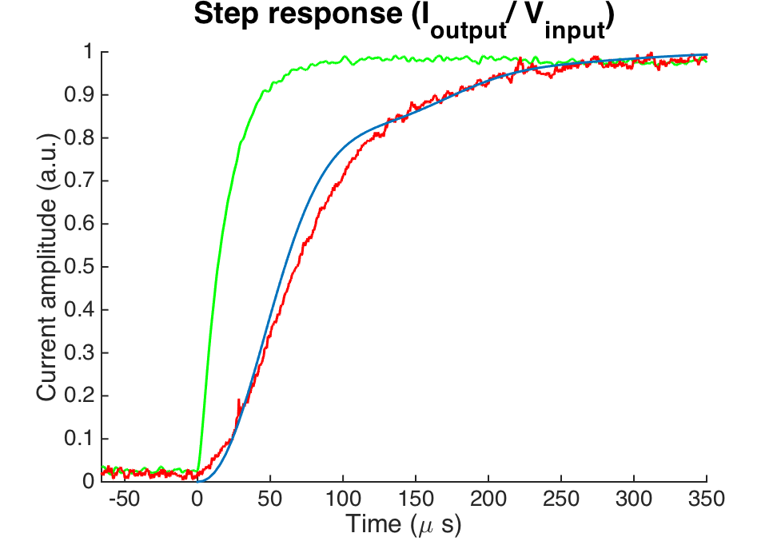
Results: High performance in diverse applications
Driving 10uH load
20𝜇s rise time
50uH load
Driving 690uH load
200𝜇s rise time
Driving 25KHz resonant load
50A peak to peak
Stockmann et al., MRM 2015
Cooley et al., ISMRM 2014
Juchem et al., JMR 2010
Input step
Calculated response
Measured response

Slide 8
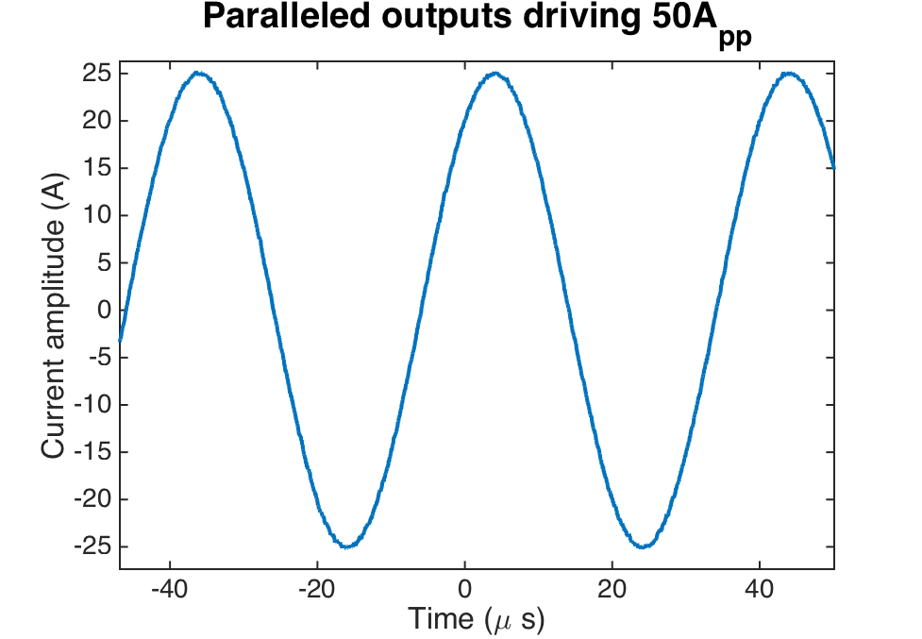
Results: High performance in diverse applications
Driving 10uH load
20𝜇s rise time
50uH load
Driving 690uH load
200𝜇s rise time
Driving 25KHz resonant load
50A peak to peak
Stockmann et al., MRM 2015
Cooley et al., ISMRM 2014
Juchem et al., JMR 2010
Input step
Calculated response
Measured response

Slide 9
Results: Simple changes allow for new applications
load
Two capacitor per channel adjustment for new loads
Lead Compensated Open Loop Bode Plot
Gain (dB)
~20KHz bandwidth
Phase (deg)
Frequency (kHz)

Slide 10
Results: Simple changes allow for new applications
Parallel outputs for larger loads
load
load
Two capacitor per channel adjustment for new loads
Lead Compensated Open Loop Bode Plot
Gain (dB)
~20KHz bandwidth
Phase (deg)
Frequency (kHz)

Slide 11
Results: Dynamic disturbance rejection
Single-turn test loop
Current driver
15 cm
from isocenter
Position test loop 15 cm from isocenter and oriented for maximum back-EMF caused by EPI readout (z) gradient slewing to maximize flux
3T scanner bore
Sequence parameters: EPI GRE sagittal, 3mm slices ascending, 1.6mm in-plane, matrix 128x128x20, 1302 Hz/pix, 0.94 echo spacing, 6/8 partial Fourier, TE=37 ms, TR=9000 ms
Notes:
READOUT ALONG Z SAY THAT THING creating a large amo

Slide 12
Results: Dynamic disturbance rejection
Position test loop 15 cm from isocenter and oriented for maximum back-EMF caused by EPI readout (z) gradient slewing to maximize flux
Gradient slew disturbance
Single-turn test loop
Current driver
3T scanner bore
Sequence parameters: EPI GRE sagittal, 3mm slices ascending, 1.6mm in-plane, matrix 128x128x20, 1302 Hz/pix, 0.94 echo spacing, 6/8 partial Fourier, TE=37 ms, TR=9000 ms

Slide 13
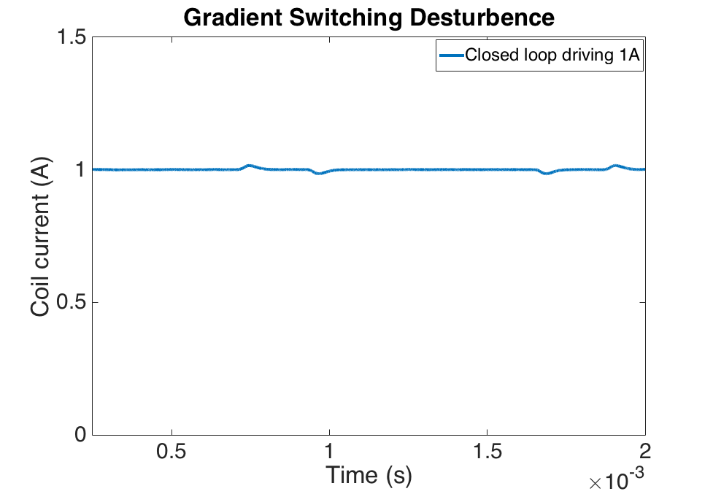
Results: Dynamic disturbance rejection
Closed loop controller rejects gradient slew
Shim current during gradient switching
Single-turn test loop
Current driver
3T scanner bore
Sequence parameters: EPI GRE sagittal, 3mm slices ascending, 1.6mm in-plane, matrix 128x128x20, 1302 Hz/pix, 0.94 echo spacing, 6/8 partial Fourier, TE=37 ms, TR=9000 ms

Slide 14
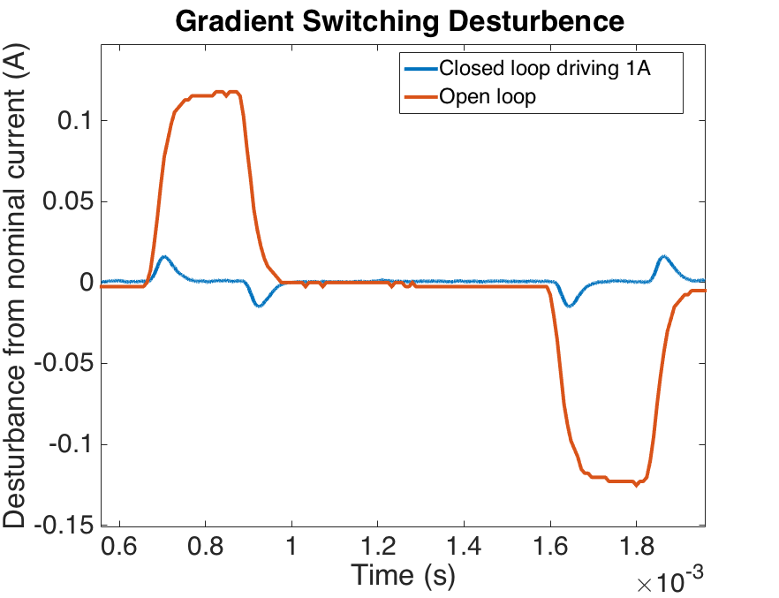
Results: Dynamic disturbance rejection
Closed loop controller rejects gradient slew
Shim current during gradient switching
Single-turn test loop
Current driver
3T scanner bore
Sequence parameters: EPI GRE sagittal, 3mm slices ascending, 1.6mm in-plane, matrix 128x128x20, 1302 Hz/pix, 0.94 echo spacing, 6/8 partial Fourier, TE=37 ms, TR=9000 ms

Slide 15
Results: Shim current can be set 500 𝜇s before image TR
Test: Update shims to +/-2A starting 500us before beginning of TR in EPI-GRE sequence
EPI magnitude images (20 slices)
shim current OFF
SNR = 48.0
shim current ON
SNR = 48.5
a.u.
+2A
0A
-2A
0A
Single-turn test loop
Current driver
Phantom
3T scanner bore
Signal ROI
Noise ROI
Sequence parameters: EPI GRE axial, 3mm slices ascending, 1.6mm in-plane, matrix 128x128x20, 1302 Hz/pix, 0.94 echo spacing, 6/8 partial Fourier, TE=37 ms, TR=9000 ms
Notes:
Shows correct distortion in the phase encode direction

Slide 16
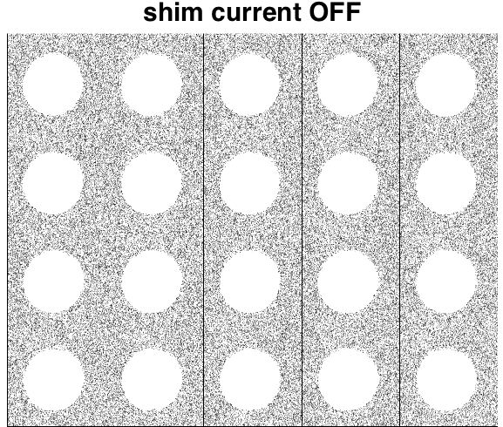
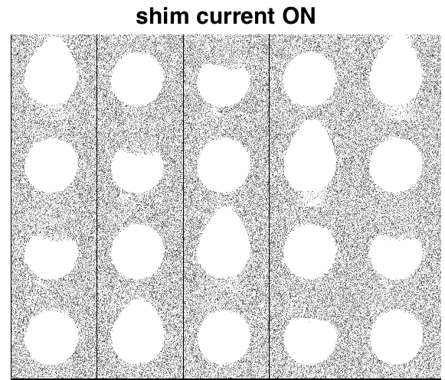
Results: No excess RF noise caused by dynamic shimming
Test: Update shims to +/-2A starting 500us before beginning of TR in EPI-GRE sequence
EPI magnitude images (20 slices)
shim current OFF
SNR = 48.0
shim current ON
SNR = 48.5
a.u.
+2A
0A
-2A
0A
Single-turn test loop
Current driver
Phantom
3T scanner bore
→ No RF “zipper” artifacts or structured noise
Sequence parameters: EPI GRE axial, 3mm slices ascending, 1.6mm in-plane, matrix 128x128x20, 1302 Hz/pix, 0.94 echo spacing, 6/8 partial Fourier, TE=37 ms, TR=9000 ms

Slide 17
Future Work: Driver board as a part of a shimming system
Equipment/console room
Magnet room
8 ch. shim driver #1
8 ch. shim driver #2
SPI Bus
Low Cost Microcontroller
Fiber Optic Driver
Fiber Optic Receiver
SPI Bus
RF Waveguide
8 ch. shim driver #7
TTL Pulse
Scanner Console
64 channel update in under 500 microseconds
8 ch. shim driver #8
64 channel update in under 500 𝜇s

Slide 18
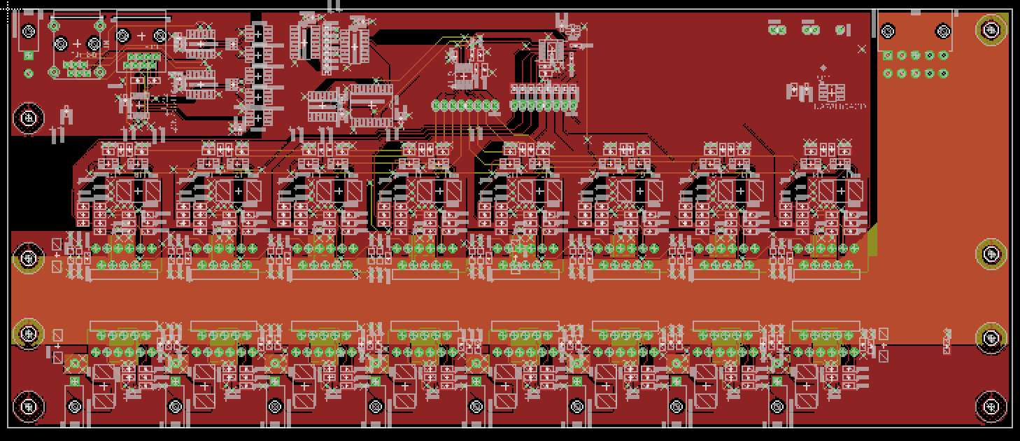
Conclusions
Showed open source, low-cost current driver board tailored for multi-coil shimming (up to 5A DC)
Under $70 per channel
Demonstrated dynamic shimming ability
Stable currents under heavy gradient slewing (EPI)
Low noise operation in magnet room
Limitation: Requires water cooling for high duty cycles
Boards and simulation codes available at rflab.martinos.org

Slide 19
Conclusions
Showed open source, low-cost current driver board tailored for multi-coil shimming (up to 5A DC)
Under $70 per channel
Demonstrated dynamic shimming ability
Stable currents under heavy gradient slewing (EPI)
Low noise operation in magnet room
Limitation: Requires water cooling for high duty cycles
Boards and simulation codes available at rflab.martinos.org
Notes:
“IN conclusion”

Slide 20
Conclusions
Showed open source, low-cost current driver board tailored for multi-coil shimming (up to 5A DC)
Under $70 per channel
Demonstrated dynamic shimming ability
Stable currents under heavy gradient slewing (EPI)
Low noise operation in magnet room
Limitation: Requires water cooling for high duty cycles
Boards and simulation codes available at rflab.martinos.org
More user-friendly Rev B board forthcoming. Application and feature suggestions welcome
Notes:
“IN conclusion”

Slide 21
Acknowledgements
Grant support: Skoltech
Grant support: NIH R21 EB017338 and P41 EB015896
Notes:
I thank my sponsors for funding and you for your attention

